Slide 1
Microprocessors and Microcontrollers

Slide 2
INTERRUPT

Slide 3
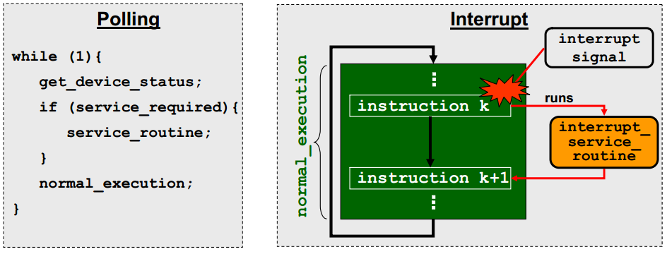
Interrupts vs. Polling

Slide 4
Interrupts vs. Polling
Using polling
the CPU must continually check the device’s status.
Using interrupt
A device will send an interrupt signal when needed.
In response, the CPU will perform an interrupt service routine, and then resume its normal execution.

Slide 5
Interrupts vs. Polling
Efficiency
Monitoring several devices
Priority

Slide 6
Interrupt execution sequence
A device issues an interrupt
CPU finishes the current instruction
CPU acknowledges the interrupt
CPU saves its states and PC onto stack
CPU loads the address of ISR onto PC
CPU executes the ISR
CPU retrieves its states and PC from stack
Normal execution resumes

Slide 7
ATmega16 interrupt subsystem
The ATmega16 has total 21 interrupts
We focus on 16 of them
3 external interrupts
8 timer interrupts
3 serial port interrupts
1 ADC interrupt
1 SPI interrupt

Slide 8
ATmega16 interrupt subsystem
The ATmega16 has total 21 interrupts
There are 5 others
1 reset interrupt
1 analogue comparator interrupt
1 TWI interrupt
2 memory interrupts

Slide 9
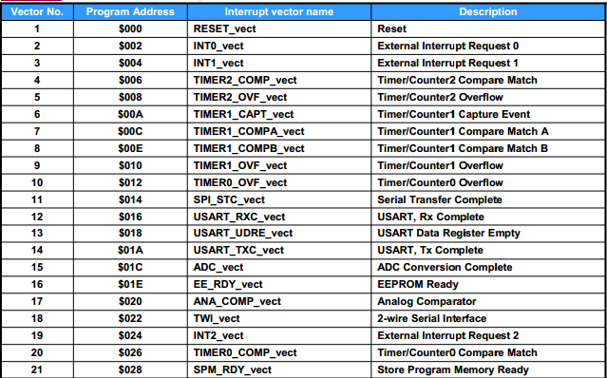
Complete List

Slide 10
Complete List
Vector No.
An interrupt with a lower ‘Vector No’ will have a higher priority.
INT0 has a higher priority then INT1 and INT2

Slide 11
Complete List
Program Address.
The fixed memory location for a given interrupt handler.
E.g., in response to interrupt INT0, CPU runs instruction at $002.
Usually the instruction is
JMP address (address of ISR)

Slide 12
Complete List
Vector names
to be used with ISR

Slide 13
Complete List
Description

Slide 14
Steps to program an interrupt in C
Include header file <avr\interrupt.h>.
Use C macro ISR() to declare the interrupt handler and update IVT.
Configure details about the interrupt by setting relevant registers.
Enable the specific interrupt.
Enable the interrupt subsystem globally using sei(). (Set Global Interrupt)

Slide 15
ISR
Basic Construct
ISR(interrupt vector name)
{
//to do logic
}

Slide 16
ISR
To handle external interrupt 1
ISR(INT1_vect)
{
//to do logic
}

Slide 17
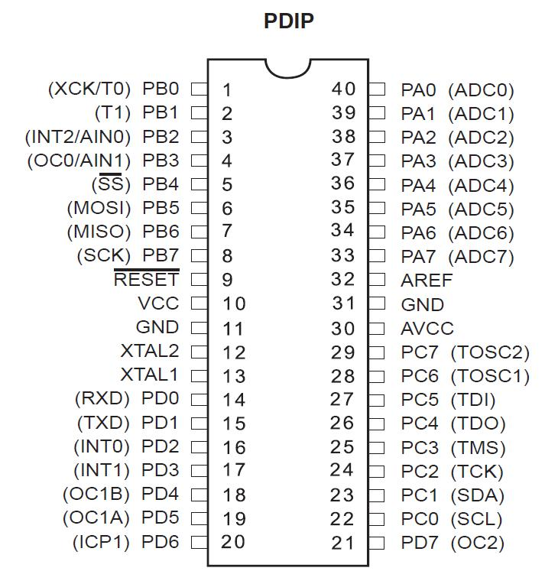
External Interrupts
Three external interrupts
INT 0
INT 1
INT 2

Slide 18
External Interrupts
Key steps in using external interrupts.
Specifying what types of event will trigger the interrupt (Step 3)
Enabling the interrupt (Step 4)

Slide 19
Specifying Events that Trigger Interrupt (Step 3)
2 registers
MCU Control Register (For INT0 and INT 1)
MCU Control and Status Register (For INT2)

Slide 20
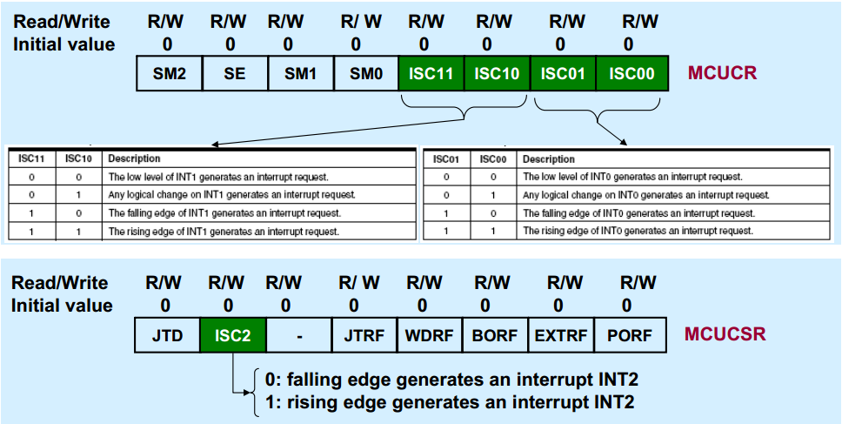
Specifying Events that Trigger Interrupt (Step 3)
ISC = Interrupt Sense Control

Slide 21
Specifying Events that Trigger Interrupt (Step 3)
To specify that INT1 is triggered on any change in pin D.3 MCUCR = (1<<ISC10);

Slide 22
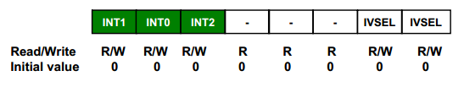
Enabling the interrupt (Step 4)
GICR (General Interrupt Control Register) register is used to enable external interrupts
To enable Interrupt 1
GICR = (1<<INT1);
INT1 is defined in io.h

Slide 23
TOGGLE THE CONTENT OF PORT B USING INTERRUPT, WHENEVER A CERTAIN SENSOR CONNECTED TO PD3 GOES FROM HIGH STATE TO LOW STATE

Slide 24
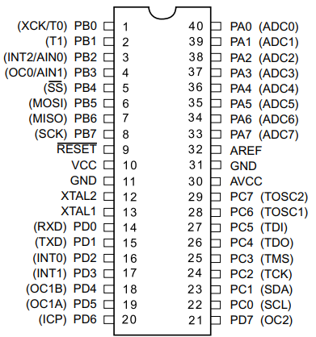

Slide 25
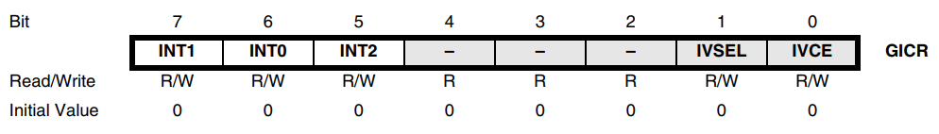
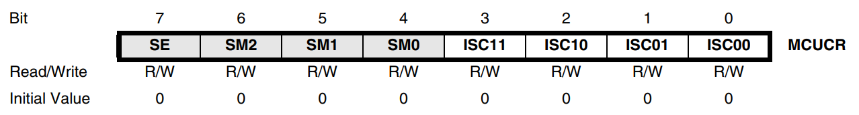
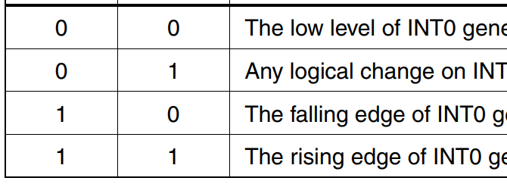
#include <avr/io.h>
#include <avr/interrupt.h> //STEP1
ISR(INT1_vect)//STEP2
{
PORTB = ~PORTB;
}
int main(void)
{
DDRB = 0xFF;
PORTB = 0b01010101;
GICR = (1 << INT1); //STEP3
MCUCR = MCUCR | (1 << ISC11);//STEP4
MCUCR = MCUCR & (~(1 << ISC10));//STEP4
sei();//STEP5
while(1);
}

Slide 26
Why do we need while(1);
To keep program alive to receive interrupts

Slide 27
Disabling global interrupt
You typically turn off interrupts when you are doing a task that should not be interrupted.
One example is reading/writing 16-bit values like TCNT1. (Details will be discussed when we study Timer)
The cli() macro is used to disable all interrupts by clearing the global interrupt mask.
interrupts that are triggered during that time be deferred until sei() (is executed and happen immediately thereafter)
https://www.avrfreaks.net/forum/clisei-are-interrupts-skipped-or-deferred

Slide 28
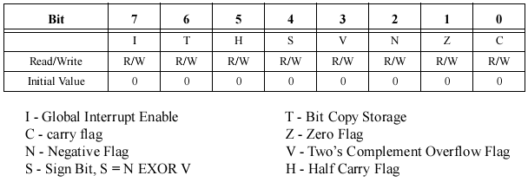
Status Register (SREG)
sei() and cli() sets and clears I(7th) bit in SREG

Slide 29
Nested Interrupts
The global interrupt is disabled by hardware when an interrupt has occurred
By default, nested interrupt is disabled in ATmega32
Global interrupt is set again by the RETI instruction to enable subsequent interrupts. This is done automatically by the compiler.
However, to enable nested interrupts it can be enabled manually with the sei() in the ISR.

Slide 30
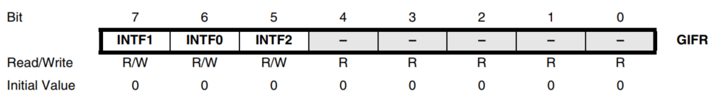
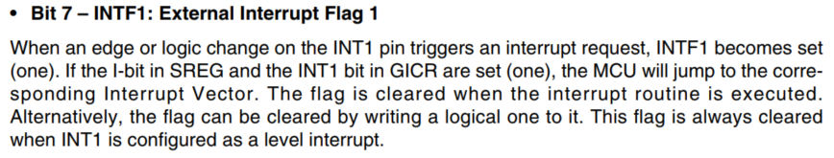
Global Interrupt Flag Register
Datasheet, page 68
https://www.avrfreaks.net/forum/clearing-pending-interrupts

Slide 31
ISR Usage
understand how often the interrupt occurs
understand how much time it takes to service each interrupt
make sure there is enough time to service all interrupts and to still get work done in the main loop
Keep ISRs Short and Simple. (short = short time, not short code length)
Do only what has to be done. Long ISRs may preclude others from being run

Slide 32
Use of volatile
As ISRs are not called from main or any other function, it can not take argument or return any values
We have to use global variables
We must use volatile to declare such variables
why ??

Slide 33
Use of volatile
Compilers can optimize away some variables
It does so when it sees that the variable cannot be changed within the scope of the code it is looking at
variables changed by the ISR are outside the scope of main()
thus, they get optimized away

Slide 34
Use of volatile
volatile uint8_t tick; //keep tick out of regs!
ISR(TIMER1_OVF_vect){
tick++; //increment my tick count
}
main()
{
while(tick == 0x00)
{
bla, bla, bla...
}
}
Without volatile volatile modifier, -02 optimization removes tick because nothing in while loop can ever change tick

Slide 35
Resource
ATMega Datasheet
http://web.engr.oregonstate.edu/~traylor/ece473/lectures/interrupts.pdf
http://www.avrfreaks.net/forum/nested-interrupts-2

Slide 36
☺

